Slide 1
TSQL FUNDAMENTALS

Slide 2
History of SQL
During the 1970s(IBM), Structured English Query Language(SEQUEL)
Select Query Language (SQL), which included commands allowing data to be read only for reporting and record look-up.
Structured Query Language
American National Standards Institute and officially called the ANSI SQL standard, established in 1986

Slide 3
In 1987, SQL became an international standard and was registered with the International Organization for Standardization (ISO) using its previously copyrighted title, ANSI SQL

Slide 4
1986 SQL-86 First published by ANSI. Ratified by ISO in 1987.
1989 SQL-89 Minor revision, adopted as FIPS 127-1.
1992 SQL-92 Major revision (ISO 9075), Entry Level SQL-92 adopted as FIPS
1999 SQL:1999 Added regular expression matching, recursive queries, triggers, support for procedural and control-of-flow statements, non-scalar types, and some object-oriented features.
2003 SQL: 2003 Introduced XML-related features, window functions, standardized sequences, and columns with auto-generated values (including identity-columns).
2006 SQL: 2006 ISO/IEC 9075-14:2006 defines ways in which SQL can be used in conjunction with XML. It defines ways of importing and storing XML data in an SQL database, manipulating it within the database and publishing both XML and conventional SQL-data in XML form.
2008 SQL: 2008 Defines more flexible windowing functions

Slide 5
T-SQL
T-SQL is Microsoft's implementation of a SQL.
T-SQL is the language used to talk to SQL Server.
SQL Server 2000 implements ANSI-92.
SQL Server 2005 implements ANSI-99.
T-SQL does not fully conform to any of the more recent ANSI versions, but it does implement many of the selected features.

Slide 6
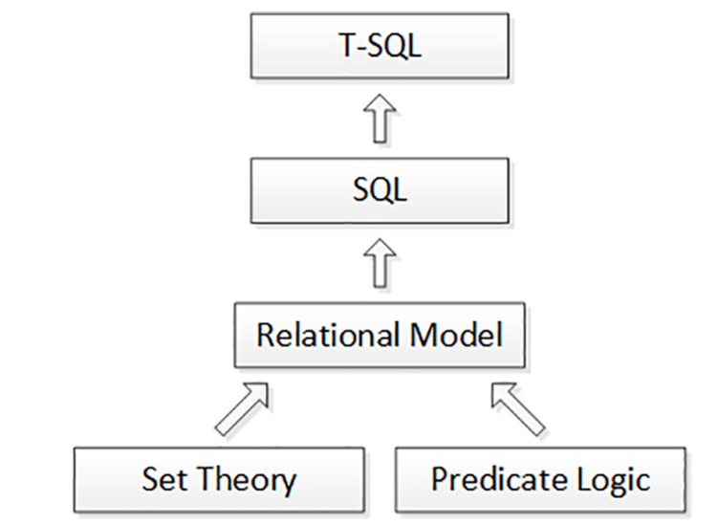

Slide 7
Misconception
„relational“ doesn‘t refer to relationships between tables
Mathematical concept relation
RELATION IN RELATIONAL MODEL IS WHAT SQL REPRESENTS WITH A TABLE

